Slide 1

Welcome Welcome
Pre-proposal Meeting
July 30th, 2026

Slide 2
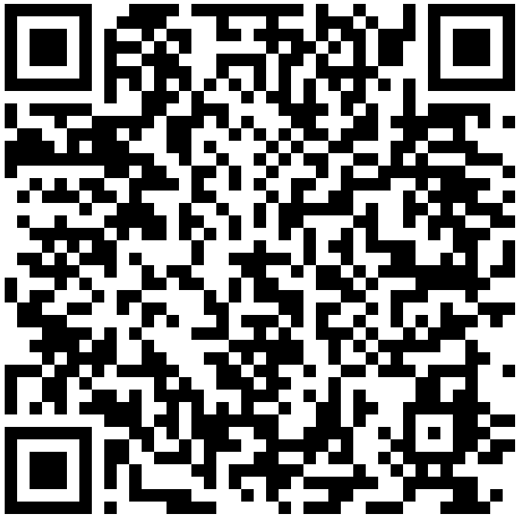
State of Indiana Bidder Profile
A bidder profile with IDOA is required to access the Indiana Supplier Portal and to submit bid responses.
Scan the QR Code to access Supplier Portal Information.
Before an award may be granted, the bidder must be registered with the Secretary of State

Slide 3
Pre-Proposal Breakout Meeting Information
Topics for event-specific sessions:
Key Dates
Term of Contract
Purpose of RFP
Scope of Work
Q&A
The specific location(s) and Time(s) of each Breakout meeting will be listed on the last slide.
Notes:
Key dates include: Issuance of the RFP, Deadline to submit the preproposal networking form and written questions, responses to questions/RFP amendments, deadline for submission of proposal (incl all required documents), deadline for submission of ref. check forms, and the anticipated time for preliminary award.

Slide 4
Pre-Proposal Main Meeting Information
General Information
Proposal Preparation
Evaluation Criteria
Indiana Veteran Owned Small Business Enterprises (IVOSB)
Submission Requirements
Optional Forms/Documents
Required Forms/Documents
Additional Information
Questions (Attachment G)

Slide 5
General Information
Potential Respondents are typically given the opportunity to express interest in a solicitation and to have their company and contact information posted to the solicitation website by submitting the Pre-Proposal Network Opportunities Form (Attachment I).
The form is optional but must be submitted to rfp@idoa.in.gov by the date and time specified in the documents for each solicitation.
Potential Respondents are encouraged to submit any questions pertaining to a solicitation via the Question/Inquiry process, using Attachment G.
Specific deadlines for each event are listed in the published solicitation document(s) (RFP Main Document).
Notes:
Potential Respondents = Both Primes and Subs.
Remember that only questions/answers provided in writing may be considered binding on the State.

Slide 6
Submission Forms/Documents
Additional forms may also be required depending on the event.
Use the templates provided for all responses and do not alter any templates.
Responses must be submitted per the RFP instructions. See RFP Sections 1.8 and 2.1 for additional details. Late submissions, emailed or hand-delivered submissions will not be accepted.
Please see the Key Dates section (RFP Main Document) of each solicitation to confirm due dates for these items.

Slide 7
Required Submission Forms/Documents
Attachment C – Indiana Economic Impact Form
Attachment D – Cost Proposal Template
Attachment E – Business Proposal Template
Attachment F – Technical Proposal Template
Attachment H – Reference Check Forms
Must be completed by the reference and emailed directly to the State
Attachment J – Attestation Form
Notes:
Cloud Questionnaire and Infrastructure Overview Forms

Slide 8
Executive Summary
The Executive Summary must be completed and submitted via the online submission process. At a minimum, your Executive Summary must address the following (also outlined in Section 2.2 of the RFP):
Summarize your ability and desire to supply the required services;
Make sure the Executive Summary is signed by an authorized representative;
Include your primary contact
State your understanding of the respondent notification; and
Indicate status regarding Secretary of State registration.
You may include additional “cover letter” information within the Executive Summary if desired.

Slide 9
Attestation Form
The Attestation Form (Attachment J) must be completed.
Mandatory Submission and Requirements
Confirm Mutual Understanding and Submission
Claim Clarification (Buy Indiana), if applicable
Subcontractors per RFP 2.3.10
Confidential / Redacted File Information

Slide 10
Confidential Information
Confidential Information (RFP Main Document - Section 1.15)
All materials contained in proposals are subject to the Access to Public Records Act (APRA) and can be accessed by any member of the public after contract award. The responses are deemed to be “public records” unless a specific provision of IC 5-14-3 protects parts of the response from disclosure.
In order to request certain information be kept confidential, Respondents must claim a statutory exception to the APRA in their Attestation Form (Attachment J), including a description of which specific provision applies to any specific part of their response.
Confidential information must also be clearly marked and kept separate from the proposal in the electronic copies. IDOA recommends sending a “public” file that has the confidential information redacted (may be in PDF format) and a “final” file that includes all required information (must be in format provided).
A redacted version must be submitted along with the Confidential copy.
DO NOT LABEL YOUR ENTIRE RESPONSE AS CONFIDENTIAL.

Slide 11
Indiana Economic Impact Form (IEI)
Attachment C
Respondents must submit this completed attachment, but it will not be used for evaluation purposes.
Definitions of FTE (Full-Time Equivalent)
Example: If a Respondent has five (5) full time employees, is bidding on its 5th contract, and all contracts get an equal amount of commitment from the employees, then each employee commits 20% of his/her time to the new contract:
0.2 x 5 employees –1 FTE

Slide 12
Cost Proposal
Attachment D
Please complete the template provided for the Cost Proposal by populating ONLY the yellow shaded cells. The Total Cost will populate automatically. The Cost Proposal must be returned in the original Excel format. (No PDFs.)
Cost Proposals are scored based on the Total Cost for the initial term. Using an estimated 30 point score for the Cost, the lowest cost proposal receives a total of 30 points. The normalization formula is as follows:
Respondent’s Cost Score = (Lowest Cost Proposal / Total Cost of Proposal) X 30
Notes:
(Total Cost in cell E8of the Cost Proposal)

Slide 13
Cost Proposal
The Respondent should provide a brief narrative (not longer than two pages) in support of each Cost Proposal item and return this document in a PDF format, labeled as “Cost Proposal Narrative.”
The Respondent should list and describe as part of its Cost Proposal any special cost assumptions, conditions, and/or constraints relative to, or which impact, the prices presented on the Cost Schedules. The Respondent should return this document in a PDF format, labeled as “Cost Assumptions, Conditions and Constraints”.

Slide 14
Business Proposal
Attachment E
Company Financial Information (Section 2.3.4)
Respondents must provide documents to demonstrate financial stability including, for example, the most recent Dunn & Bradstreet Business Report (preferred) or audited financial statements for the two (2) most recently completed fiscal years. If neither of these can be provided, Respondents must explain why and include an income statement and balance sheet for each of the two (2) most recently completed fiscal years.
If the documents are from a parent or holding company, Respondents must explain the business relationship between the entities and demonstrate the financial stability of the entity which is directly responding to this RFP.

Slide 15
Business Proposal
Contract Terms (Section 2.3.6)
Respondents should review sample State contract and note exceptions to State non-mandatory clauses in Business Proposal and Executive Summary.
The State may refuse to consider any redlines requested in negotiation of a contract that were not specifically identified and included in a vendor’s response.
Mandatory clauses are non-negotiable.

Slide 16
Business Proposal
References (Section 2.3.7)
Often, Respondents must have at least three (3) references who:
Can speak to the Respondent’s experience in providing products and/or services that are the same, or similar, to those products and/or services requested in this solicitation
Can speak to the Respondent’s performance on contracts of similar scope for government clients
Respondents must ask each reference to complete Attachment H (Reference Check Form) and email it directly to IDOA (idoareferences@idoa.in.gov) by the date specified in the solicitation.

Slide 17
Technical Proposal
Attachment F
Every point made in each section must be addressed in the order given. The same outline numbers must be used in the response.
Where appropriate, supporting documentation may be referenced by a page and paragraph number. However, when this is done, the body of the Technical Proposal must contain a meaningful summary of the referenced material.
The referenced document must be included as an appendix to the technical proposal with referenced sections clearly marked.
If there are multiple references or multiple documents, these must be listed and organized for ease of use by the State.

Slide 18
Optional Submission Forms/Documents
Submission of these documents is optional and does not impact your ability to submit a proposal.
Attachment I - Pre-Proposal Networking Opportunity Form
Attachment G - Questions and Answers Form
Please see the Key Dates section (RFx Main Document) of each solicitation to confirm due dates for these items.

Slide 19
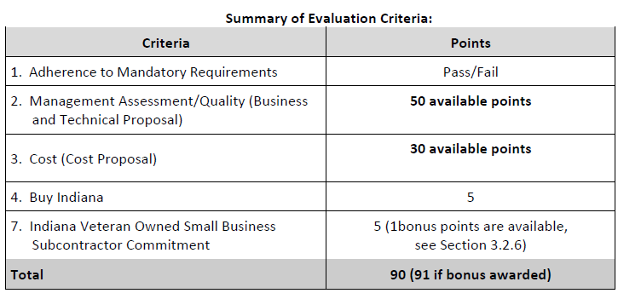
Evaluation Criteria
Notes:
This is an example of our typical eval criteria, but these can vary somewhat from event to event. Be sure to read the RFP carefully.

Slide 20
Indiana Veteran Owned Small Business
Contact Information
Phone: 317-232-3061
E-mail: Indianaveteranspreference@idoa.in.gov
Web: www.in.gov/idoa/2862.htm
Complete Attachment A1, IVOSB Form
Include sub-contractor letters of commitment
Goals for Proposal
3% Veteran Owned Small Business of Total Bid Amount

Slide 21
Indiana Veteran Owned Small Business
Prime contractors should note the following:
Pursuant to 25 IAC 9-4-1(c), a Prime Contractor who is an IVOSB can use their own workforce to count toward the goal.
IVOSB must have a Bidder ID (see section 2.3.7 - Department of Administration, Procurement Division).
Prime contractor and/or subcontractors’ Certification Letter(s), provided by IDOA or Federal Center for Veterans Business Enterprise (VA OSDBU), must accompany the proposal to show the current status of certification.

Slide 22
Indiana Veteran Owned Small Business
Prime contractors must ensure that the proposed subcontractors meet the following criteria:
Must be listed on the IDOA Directory of Certified Firms, on or before the proposal due date.
Serve a Valuable Scope Contribution (VSC) on the engagement, as confirmed by the State.
Valuable Scope Contribution – A business function that supports the scope of this solicitation.
Provide the goods or services specific to the contract and within the industry area for which it is certified.

Slide 23

Indiana Veteran Owned Small Business
Process. IVOSB scoring is conducted based on 5 points plus a possible 1 bonus point scale.
IVOSB: Possible 5 points + 1 bonus point
Professional Services Scoring Methodology. The points will be awarded on the following schedule:
Fractional points will be awarded based upon a graduated scale between whole points. (e.g., a 0.3% commitment will receive .5 points and a 1.5% commitment will receive 2.5 points)
Submissions of 0% participation will result in a deduction of 1 point in each category
The highest submission which exceeds the goal will receive 6 points (5 points plus 1 bonus point). In case of a tie both firms will receive 6 points.

Slide 24
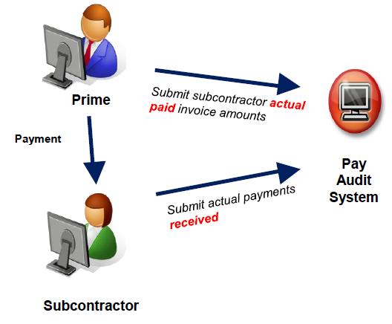
Subcontractor Compliance
Pay Audit System
Tool utilized to monitor the state’s diversity spend for subcontractors
Selected primes and subcontractors are required to report payments submitted or received through this web-based tool
Based on contract terms payments should be reported monthly or quarterly
Questions? Contact the Division of Supplier Diversity
compliance@idoa.in.gov
www.in.gov/idoa/payaudit.htm

Slide 25
Submission Requirements
You must be a registered bidder to submit a proposal.
Please refer to section 1.8 of the RFP document for instructions regarding the online submission process using the Supplier Portal.
It is your responsibility to ensure that all required documents and forms are submitted prior to the due dates. Failure to complete or submit required documents and forms may result in disqualification or loss of points.

Slide 26
Additional Resources for Bidders
Link to the bidder registry with IDOA and Secretary of State
http://www.in.gov/idoa/2464.htm
Secretary of State of Indiana
Can be reached at (317) 232-6576 for registration assistance.
www.in.gov/sos
IDOA Vendor and Supplier Resource Center
http://www.in.gov/idoa/3106.htm

Slide 27
Questions?

Slide 28
REQUEST FOR PROPOSAL 26-​​​87847 External Quality Reviews For MCO Programs
Kristine Kruger

Slide 29
Purpose of the RFP
The purpose of the RFP is to find contractors that provides External Quality Reviews ("EQR") which analyzes and evaluates aggregated information on quality, timeliness and access to healthcare services provided under the MCE programs.

Slide 30
Scope of Work
The Office of Medicaid Policy and Planning is required by the Center for Medicare & Medicaid Services (CMS) to contract with a qualified External Quality Review Organization (EQRO) to conduct all CMS required External Quality Review (EQR) activities and supporting items as described in this Statement of Work.
The Family and Social Services Administration (FSSA) is required by federal law to perform annual performance reviews of its health care programs Hoosier Healthwise (HHW), Healthy Indiana Plan (HIP), Hoosier Care Connect (HCC), and Indiana PathWays for Aging Program (PathWays). One such performance review is an External Quality Review (EQR) of contracted Managed Care Organizations (MCOs) for HHW, HIP, HCC, and PathWays.
The Contractor must perform the EQR activities as outlined in 42 CFR § 438.358 and 42 CFR § 438.360 for the Indiana Medicaid managed care programs. Specifically, the Contractor will be required to:
Develop evaluation methodologies for the EQR activities;
Perform data collection and analysis;
Prepare reports presenting evaluation findings and recommendations; and
Provide technical assistance to FSSA and its contracted MCOs.
The Contractor must complete the deliverables and requirements in accordance with the frequencies and specifications in this Contract so that the State maintains compliance with federal requirements and assures adequate oversight of Indiana’s Medicaid managed care delivery system.
The services to be provided include multiple tasks and deliverables that are consistent with applicable federal EQR regulations and protocols for MCOs.
The Contractor must have the designation as, or subcontract with, a qualified organization that is a National Committee for Quality Assurance (NCQA) certified Healthcare Effectiveness Data and Information Set (HEDIS) Consumer Assessment of Healthcare Providers and Systems (CAHPS) Survey Vendor.
The Contractor must have assigned staff who are, or subcontract with a qualified organization that has, NCQA-certified HEDIS Compliance Auditor(s).

Slide 31
Term
The term of the contract shall be for a period of four (4) years from the date of contract execution. There may be a two (2) year renewal for a total of six (6) years at the State’s option.

Slide 32
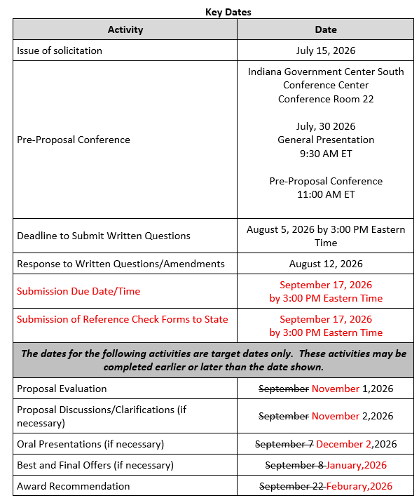
Key Dates

Slide 33
Evaluation Criteria

Slide 34
Questions?

